Slide 1
Cardiovascular Risk Prediction
CAPSTONE PROJECT
Presented By:
RASHMITA BARIK
ODISHA UNIVERSITY OF TECHNOLOGY AND RESEARCH
INFORMATION TECHNOLOGY

Slide 2
OUTLINE
Problem Statement
Proposed System/Solution
System Development Approach
Algorithm & Deployment
Result
Conclusion
Future Scope
References

Slide 3
Problem Statement
The dataset is from an ongoing cardiovascular study on residents of the town of Framingham, Massachusetts. The classification goal is to predict whether the patient has a 10-year risk of future coronary heart disease (CHD). The dataset provides the patients’ information. It includes over 4,000 records and 15 attributes. Each attribute is a potential risk factor. There are both demographic, behavioral, and medical risk factors.

Slide 4
Proposed Solution
The dataset under investigation contains information on individuals, including features such as age, education level, gender, smoking status, and various health-related measurements (e.g., cholesterol levels, blood pressure, BMI, and glucose levels). The dataset also includes a crucial target variable, "TenYearCHD," which indicates whether an individual is at risk of developing CHD within the next ten years (1 for at risk, 0 for not at risk).

Slide 5
Proposed Solution
Data Exploration: Conduct a thorough exploration of the dataset to understand its structure, identify missing values, and gain insights into the distribution of key variables.
Feature Analysis: Analyze the dataset's features to determine their suitability for predicting Ten-Year CHD risk. Categorize features as numeric, categorical, ordinal, or nominal.
Data Preprocessing: Prepare the dataset for modeling by handling missing values, encoding categorical variables, and scaling or normalizing numeric features.
Model Building: Develop predictive models using machine learning algorithms to predict Ten-Year CHD risk based on the selected features.
Model Evaluation: Assess the performance of the developed models using appropriate evaluation metrics (e.g., accuracy, precision, recall, ROC curve) to determine their predictive capability.
Interpretation: Interpret the results to identify the most influential factors contributing to Ten-Year CHD risk.

Slide 6
System Approach
The "System Approach" section outlines the overall strategy and methodology for developing and implementing the rental bike prediction system. Here's a suggested structure for this section:
System requirements
Library required to build the model
• Pandas for data manipulation, aggregation
• Matplotlib and Seaborn for visualization and behavior with respect to the target variable
• NumPy for computationally efficient operations
• Scikit Learn for model training, model optimization, and metrics calculation
Language | Python 3.10
Hardware configuration | 2 vCPU and 8 GB RAM
Software configuration | Runtime 23.1 on Python 3.10

Slide 7
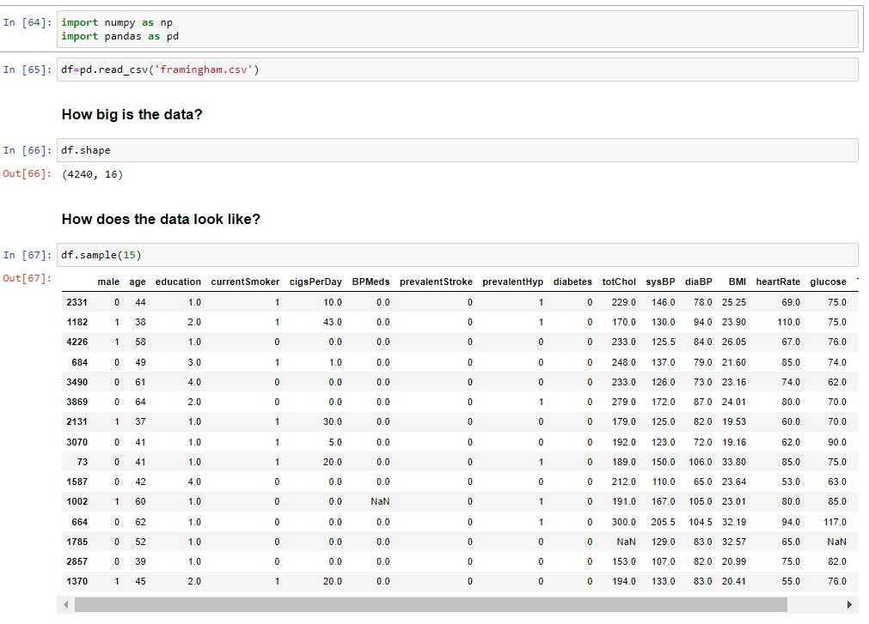
Algorithm & Deployment

Slide 8
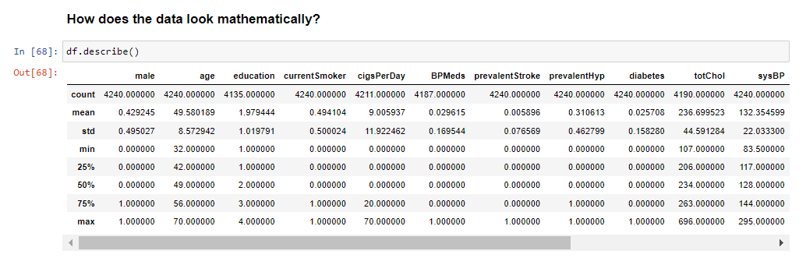
Algorithm & Deployment

Slide 9
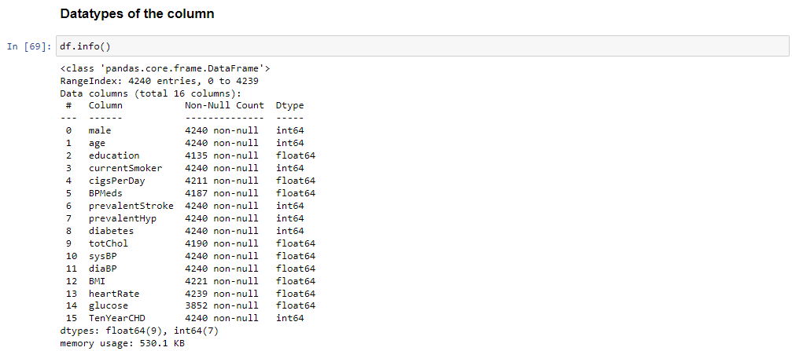
Algorithm & Deployment

Slide 10
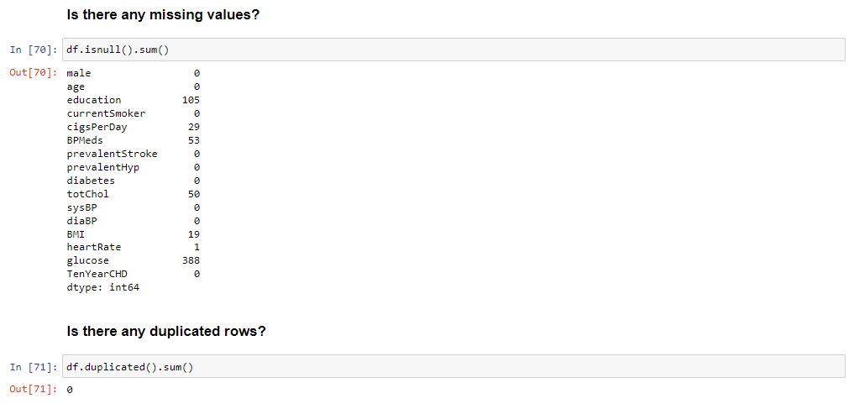
Algorithm & Deployment

Slide 11
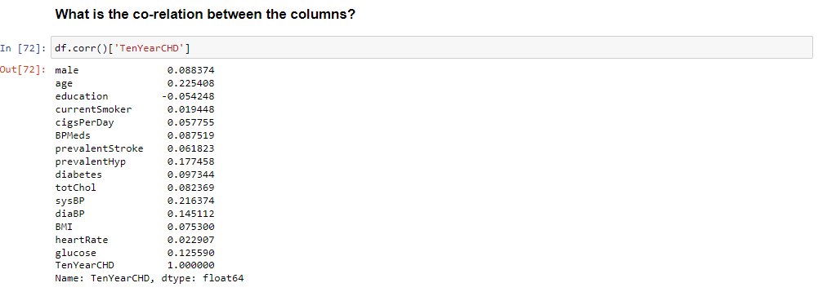
Algorithm & Deployment

Slide 12
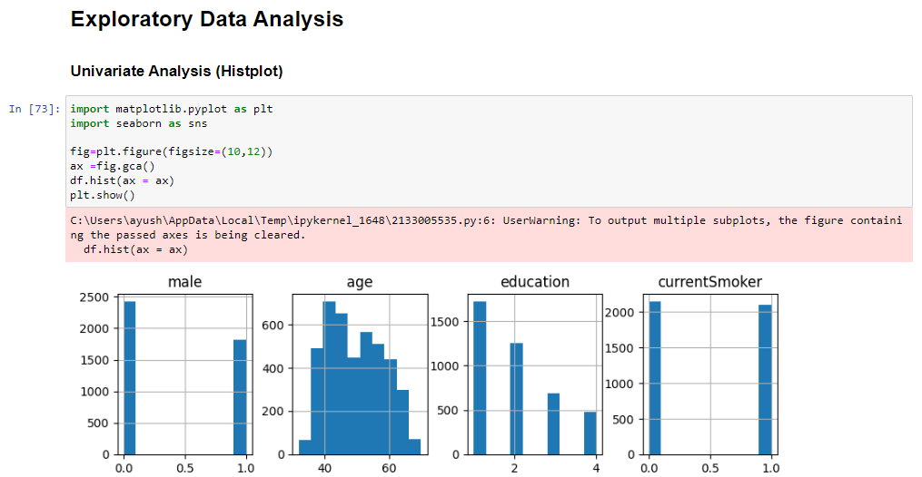
Algorithm & Deployment

Slide 13
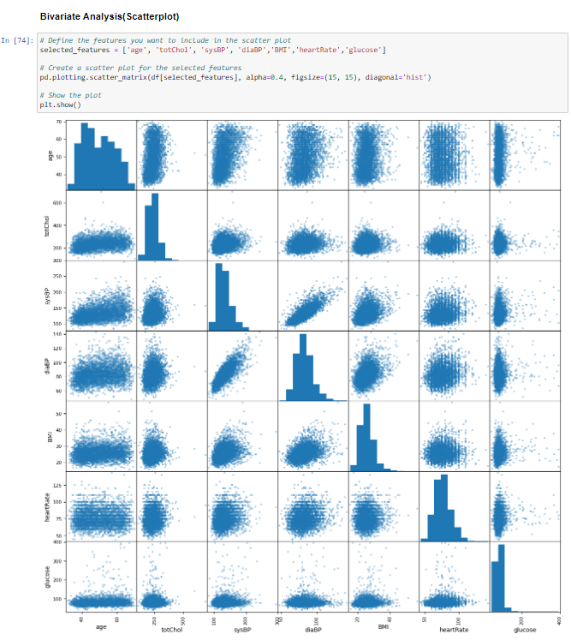
Algorithm & Deployment

Slide 14
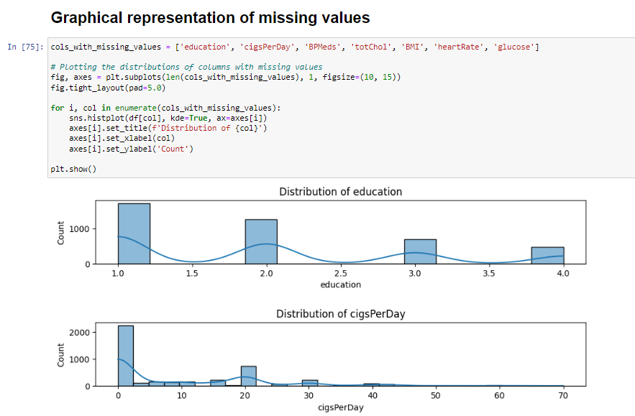
Algorithm & Deployment

Slide 15
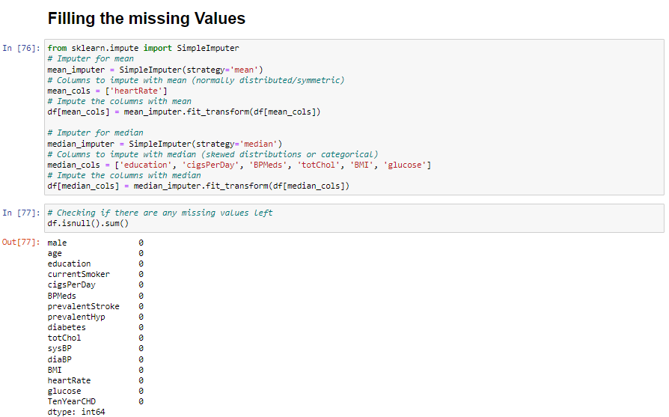
Algorithm & Deployment

Slide 16
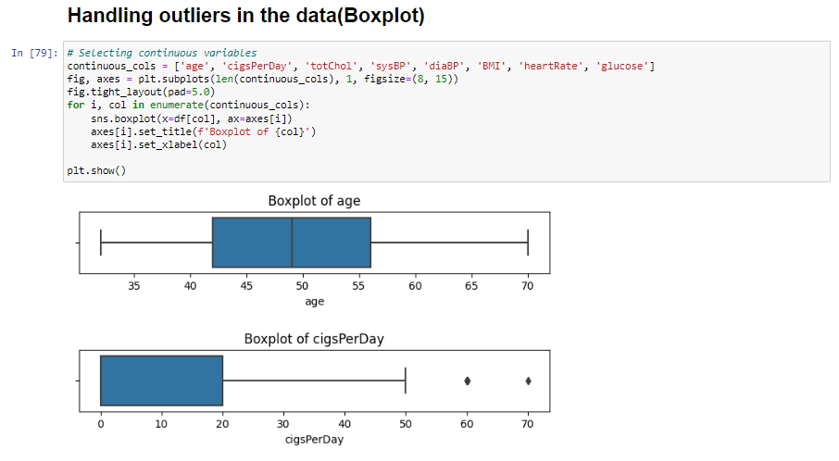
Algorithm & Deployment

Slide 17
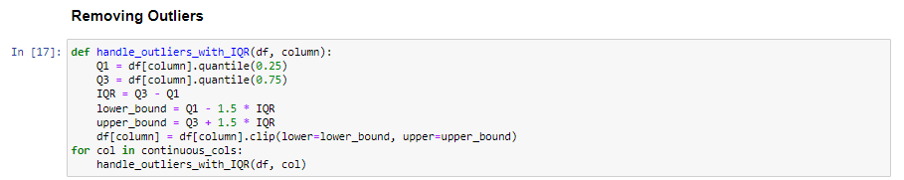
Algorithm & Deployment

Slide 18
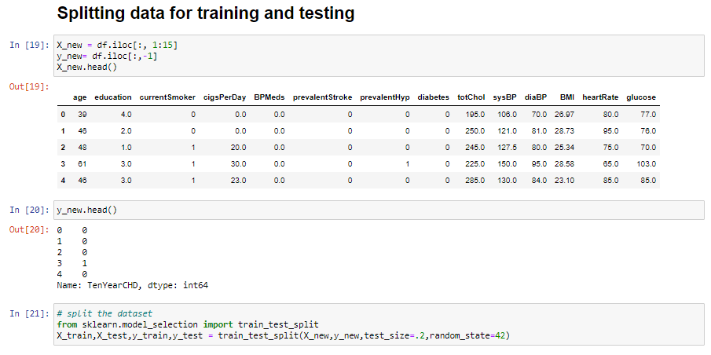
Algorithm & Deployment

Slide 19
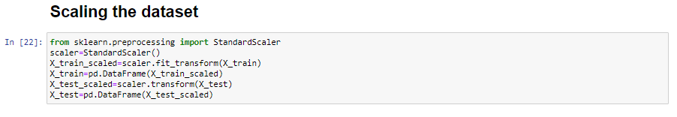
Algorithm & Deployment

Slide 20
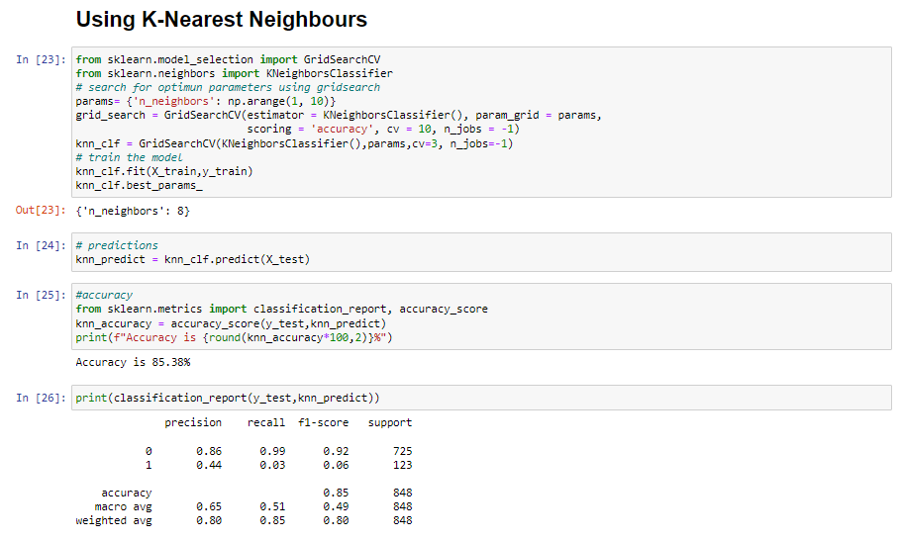
Algorithm & Deployment

Slide 21
Result
After rigorous experimentation with multiple machine learning algorithms, the K-Nearest Neighbours(KNN) emerged as the standout performer. It achieved an accuracy rate of 85.38%. This signifies that KNN excels in accurately identifying health outcomes, which is crucial for medical professionals and patients alike.

Slide 22
Conclusion
These findings hold immense promise for the healthcare domain. The ability to predict health outcomes with such precision can revolutionize patient care, leading to earlier disease detection, tailored treatment plans, and optimized healthcare resource allocation. It empowers medical practitioners with data-driven insights to make informed decisions, ultimately improving patient well-being.

Slide 23
Future scope
Discuss potential enhancements and expansions for the system. This could include incorporating additional data sources, optimizing the algorithm for better performance, and expanding the system to cover multiple cities or regions. Consider the integration of emerging technologies such as edge computing or advanced machine learning techniques.

Slide 24
References
List and cite relevant sources, research papers, and articles that were instrumental in developing the proposed solution. This could include academic papers on healthcare and data science, machine learning algorithms, and best practices in data preprocessing and model evaluation.

Slide 25
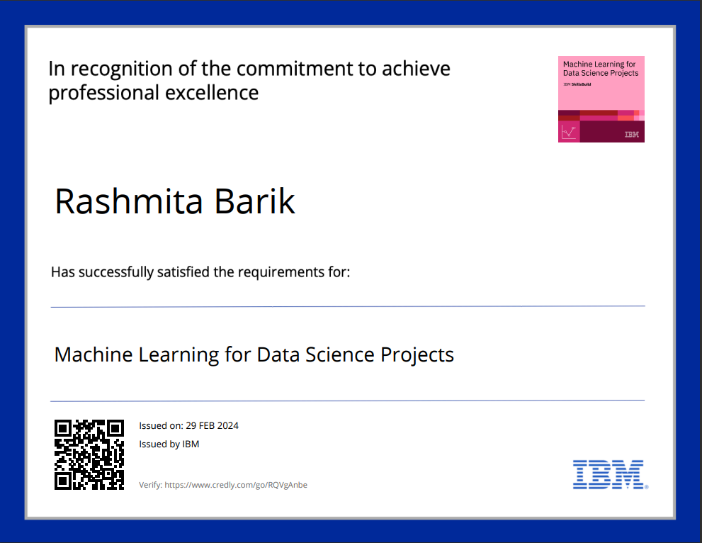
course certificate 1

Slide 26
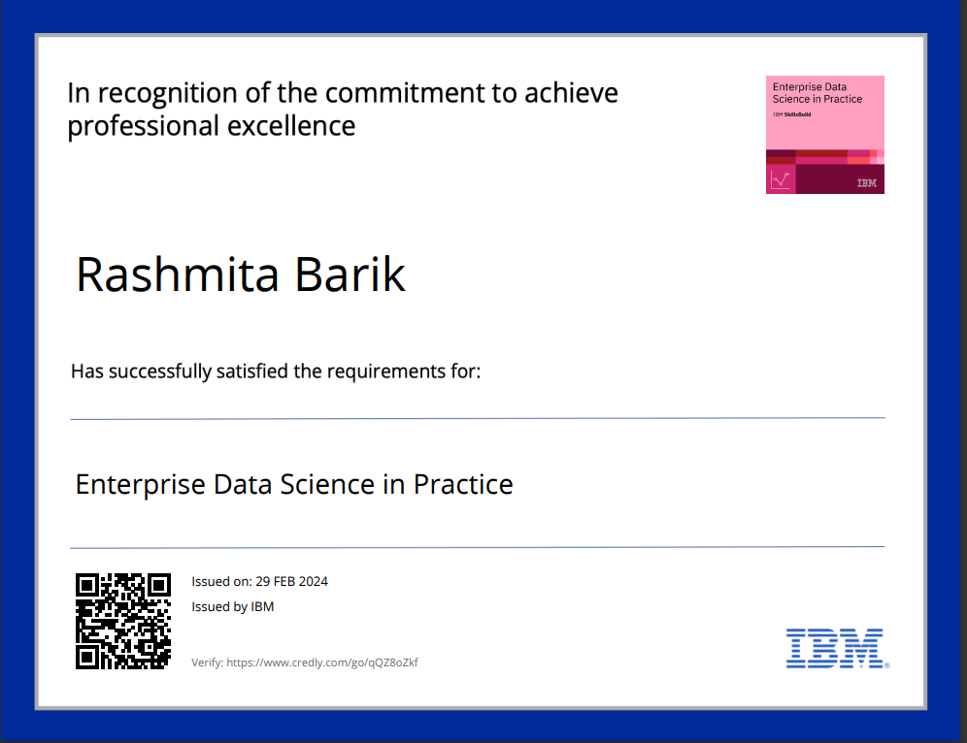
course certificate 2

Slide 27
THANK YOU

